Slide 1
THẾ GIỚI DI ĐỘNG
Group 3
Quách Văn Khánh
Lê Hoàng Thái
Nguyễn Trọng Nghĩa
Ôn Gia Lộc
Tô Ngọc Khánh Duy
Nguyễn Thành Tài

Slide 2
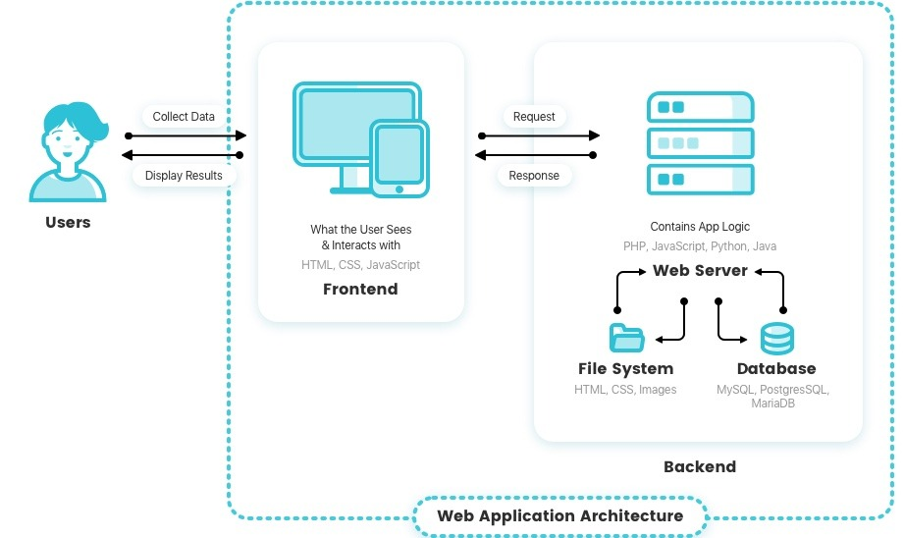

Slide 3
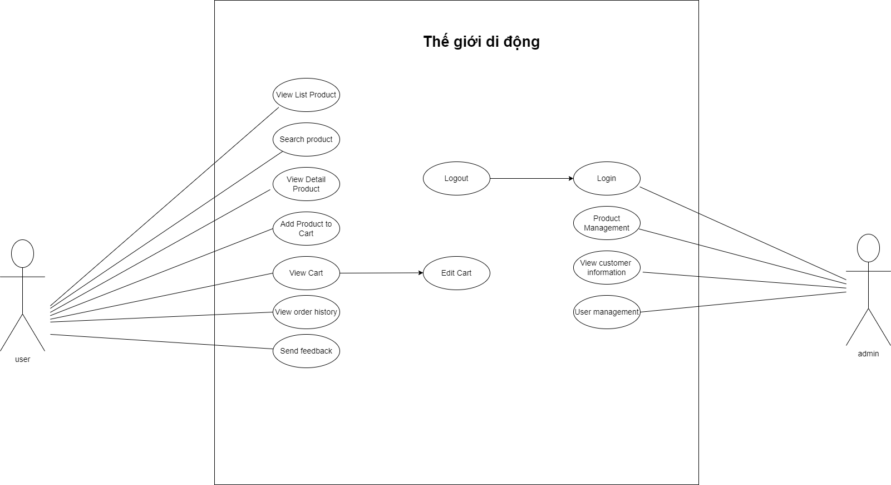
User key

Slide 4
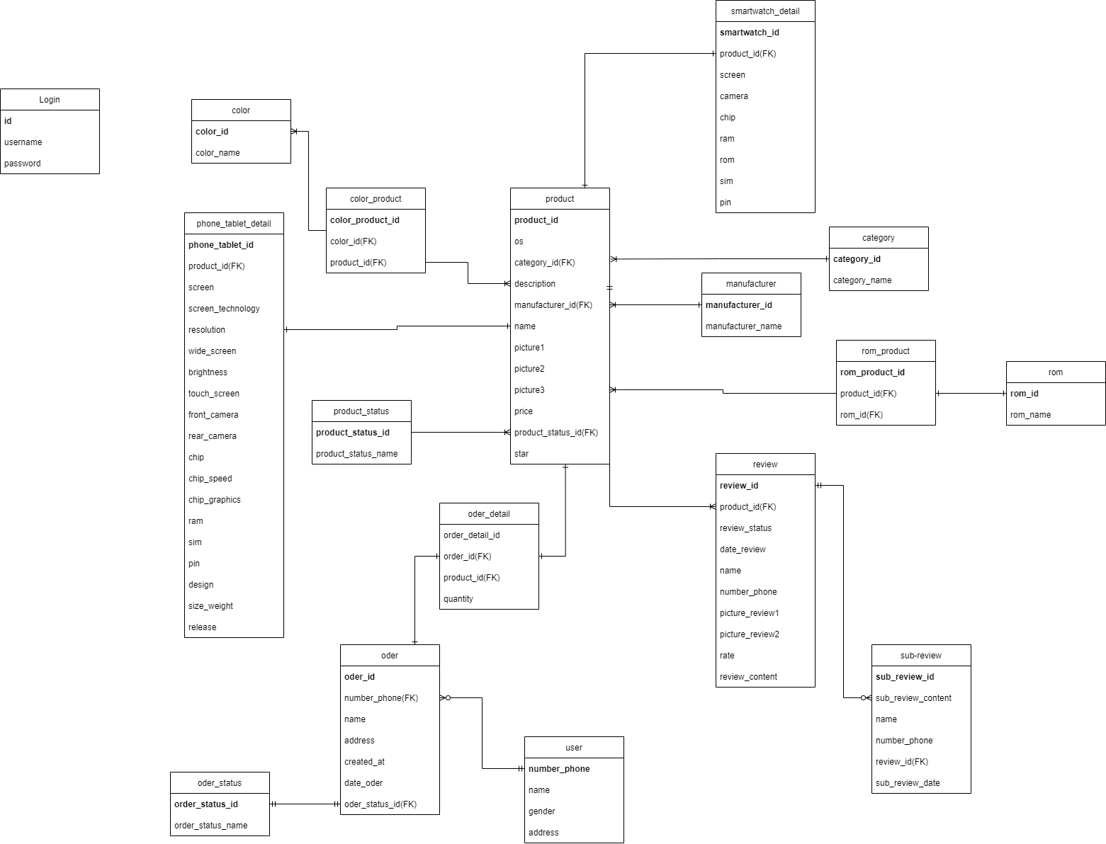
ERD

Slide 5
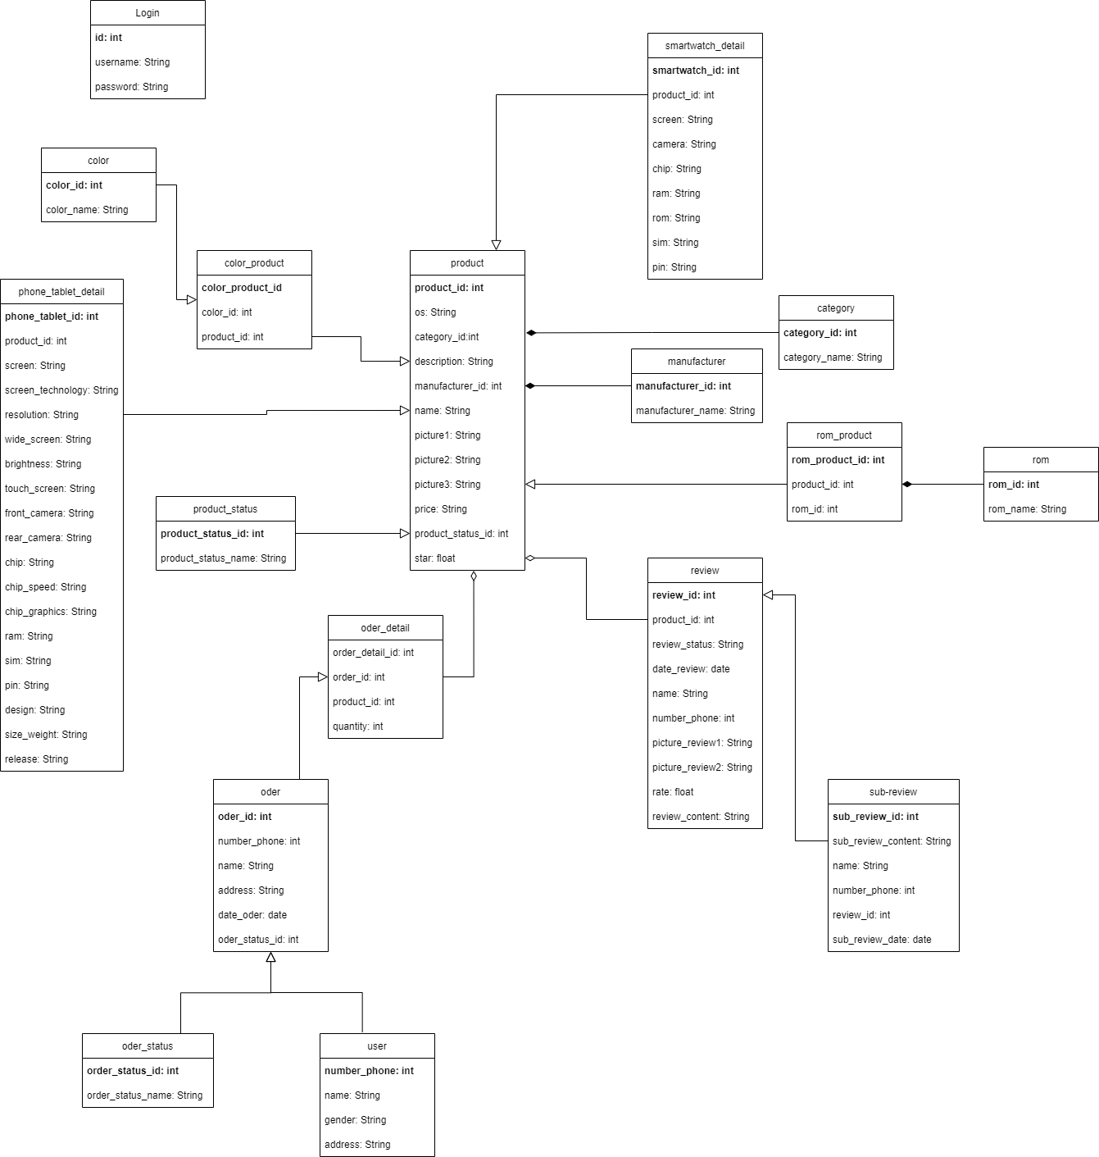
Class

Slide 6
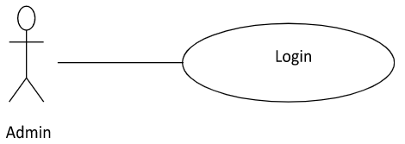
User Key Deatail
Admin login
1. The admin accesses the login page.
2. The admin fills username/password.
3. The system validates input and response error message if error happened.
4. The system redirect to add product page if correct username/password.
5. The system allows the user to perform other activities.

Slide 7
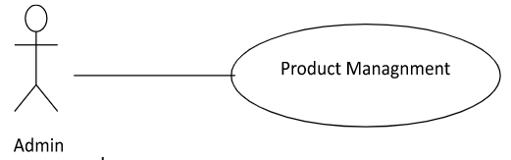
User Key Deatail
Admin Product Managnment
1. The admin accesses to add product page.
2. The admin fills new product information and click add product.
3. The system insert new product to database and clear form.
4. The system allows the admin to perform other activities.

Slide 8
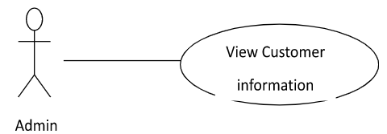
User Key Deatail
Admin View Customer information
Admin need to login to use this function
1. Admin accesses the home page.
2. System redirects to list all customers.
3. Admin clicks on customers.
4. System shows customers details.
5. Admin can edit customers' information.
6. Admin clicks “Lưu”.
7. System update information in database.
8. System return to home page.

Slide 9
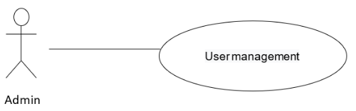
User Key Deatail
User management
1. Admin accesses the home page.
2. The system redirects to a list of all User.
3. Admin clicks “Add User” on top right.
4. Admin enter information User.
5. Admin input discount value.
6. Admin clicks “Lưu”.
7. System update information in database.
8. System returns to home page.

Slide 10
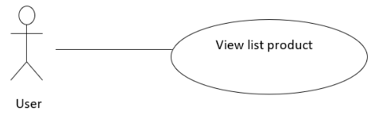
User Key Deatail
View Product List
1. The system get all products in stock.
2. The system show all products in stock to view page .

Slide 11
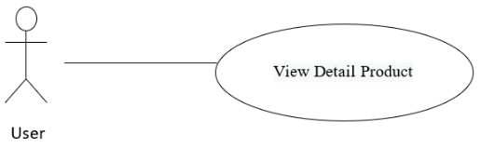
User Key Deatail
User View Detail Product
1. The User chooses one product.
2. The system gets Detail information of that product.
3. The system shows product information to Detail product view page.

Slide 12
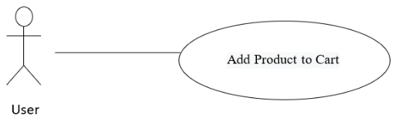
User Key Deatail
User Add Product To Cart
User accesses to view product list page.
User accesses to view specific product view page.
User choose buy now to order product.
The system get detail product information add to cart.

Slide 13
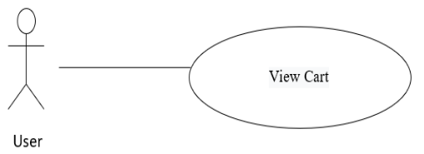
User Key Deatail
User View Cart
User accesses the home page.
The system redirects to list all products.
User clicks view cart on top right.
The system redirects to cart page.
The system allows the user to perform other activities.

Slide 14
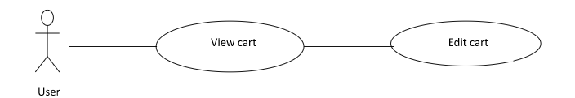
User Key Deatail
User View Cart
User accesses the home page.
User clicks view cart on top right.
The system redirects to cart page.
The system allows users to edit increase, decrease quantity, change product color and delete product.

Slide 15
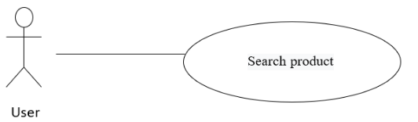
User Key Deatail
User search product
User accesses the home page.
User fills in the search box the product that the customer wants to find
The system redirects to a result set of search
The system allows the customer to perform other activities.

Slide 16
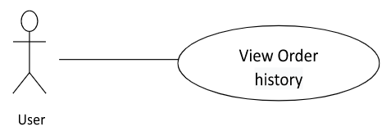
User Key Deatail
User search product
User accesses the home page.
The system redirects to list all products.
User clicks on order history at the top right.
The system redirects to the order history page.
Users can see the list of purchased orders.

Slide 17
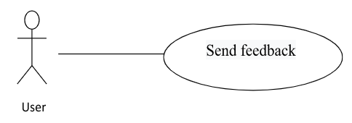
User Key Deatail
User search product
The User chooses one product.
The system shows product information to detail product view page.
Users can send feedback about that product
Feedback of user will be displayed in the product details section

Slide 18
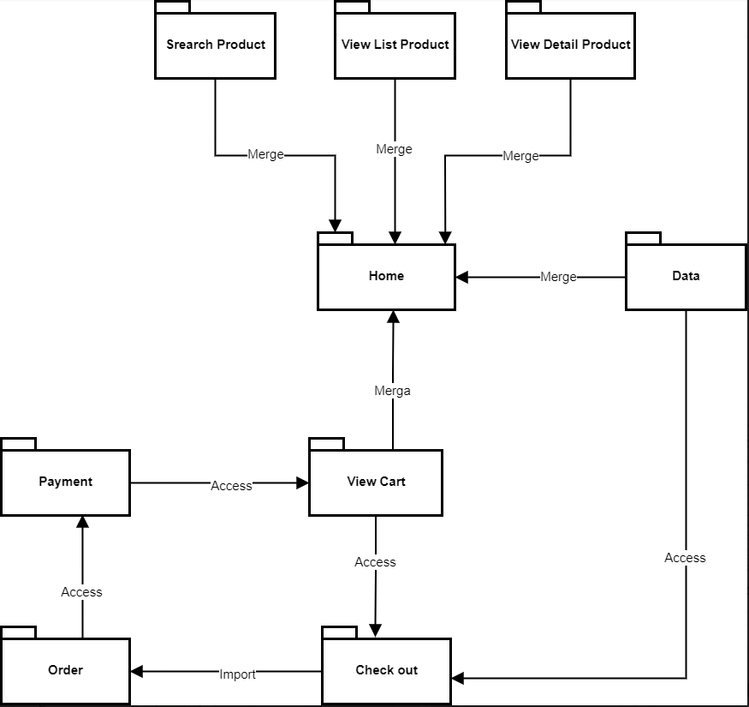
Page

